Slide 1

AN EXPERIMENTAL STUDY ON CONCRETE
BY PARTIAL REPLACEMENT WITH BAGASSE ASH,
RICE HUSK ASH AND STONE DUST
ADITYA INSTITUTE OF TECHNOLOGY AND MANAGEMENT
DEPARTMENT OF CIVIL ENGINEERING
Under the Esteemed Guidance of Submitted By
Sri. G. Gowrisankar Rao N. Ramyasri
Associate Professor (CE) 23A51D8708

Slide 2
CONTENTS
Abstract
Introduction
Objective
Literature Review
Methodology
Properties of materials
Chemical composition
Mix design of m30 grade & Beam design
Results of compression test & flexure test &Split-tensile test
Conclusion
References

Slide 3
ABSTRACT
Partial substitute of cement and sand in M30-grade concrete using BA , RHA, and Pulverized rock was investigated in the current research to study their impact on workability, mechanical strength, and durability. Inspired by cement manufacturing resulting in environmental degradation and illegal sand mining, this study seeks to facilitate sustainable construction by utilizing industrial waste and agricultural residue materials. Mix design of concrete containing different amounts of BA, RHA, and Pulverized rock were used to conduct tests of concrete load bearing capacity, Brazilian test strength, and bending strength and analyzed by non-destructive techniques like Swiss hammer test and upv tests. The findings conclude that replacement percentages can enhance the performance of concrete with minimal environmental degradation and serve as a cost-effective, green substitute for conventional materials in the construction site.

Slide 4
INTRODUCTION
Partial substitute of cement and sand in M30-grade concrete using BA , RHA, and Pulverized rock was investigated in the current research to study their impact on workability, mechanical strength, and durability. Inspired by cement manufacturing resulting in environmental degradation and illegal sand mining, this study seeks to facilitate sustainable construction by utilizing industrial waste and agricultural residue materials. Mix design of concrete containing different amounts of BA, RHA, and Pulverized rock were used to conduct tests of concrete load bearing capacity, Brazilian test strength, and bending strength and analyzed by non-destructive techniques like Swiss hammer test and upv tests. The findings conclude that replacement percentages can enhance the performance of concrete with minimal environmental degradation and serve as a cost-effective, green substitute for conventional materials in the construction site.

Slide 5
LITERATURE REVIEW

Slide 6
METHODOLOGY
Raw Materials Procurement
Properties tests on Materials
Preparation of Design mixes for concrete (M30)
Fixing the replacement percentages of Bagasse ash, Rice husk ash & Quarry dust as partial replacement of cement and F.A.
Casting of the concrete cubes, cylinder & Beams
Curing (7,14,28days)
Testing of concrete cubes & cylinders
Results and Discussions
Conclusion

Slide 7
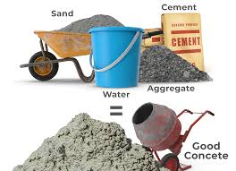
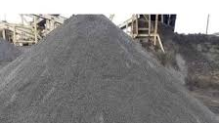
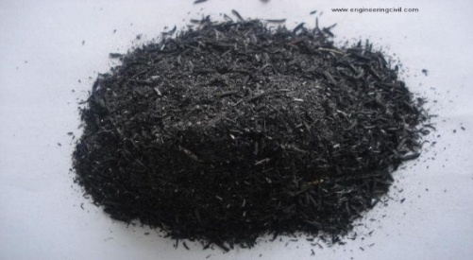
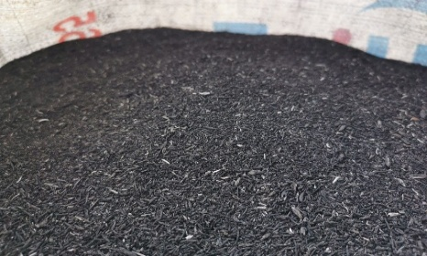
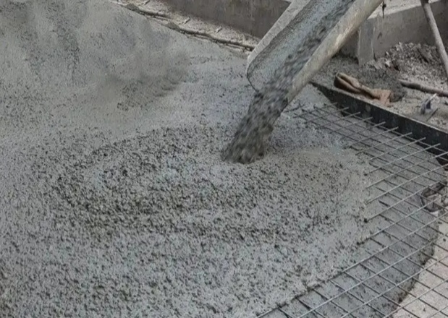
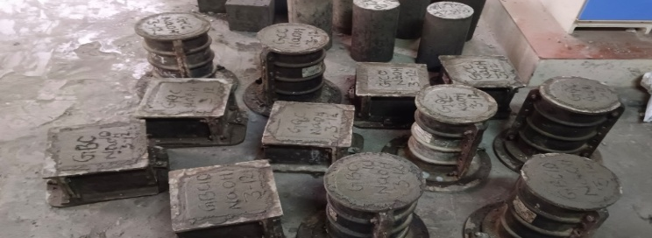
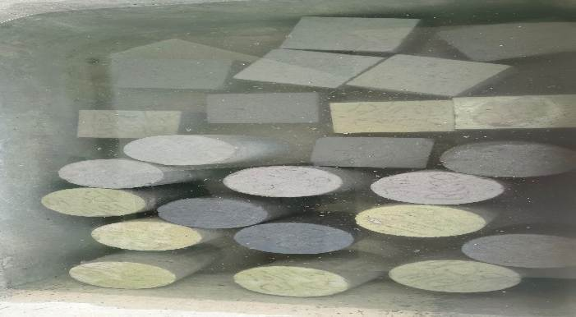
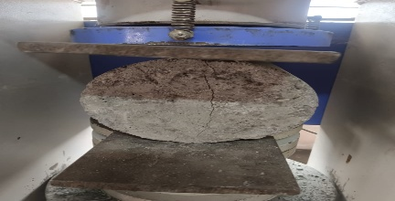
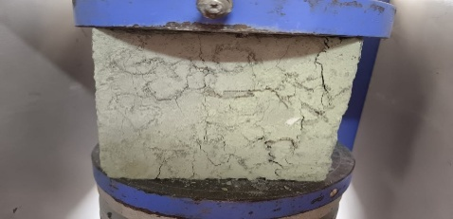
Methodology
Bagasse ash Rice husk ash Stone dust
Concrete
Casting & Curing
TESTING

Slide 8
TABLE:
Concrete load bearing capacity with replacement of manufactured sand with quarry dust, cement with BA & rice husk with different percentages
Concrete load bearing capacity
with water |  |  |  |  | with Naoh
SAMPLES | 7 Days | 14 Days | 28 Days | 56 Days | 7 Days | 14 Days | 28 Days | 56 Days
CC | 28.5 | 32.8 | 38.2 | 41.5 | 29.93 | 31.79 | 42.38 | 44.5
QC50 | 25.8 | 30.5 | 36.7 | 39.5 | 28.2 | 34.1 | 40.5 | 43
BC20 | 29 | 35.4 | 42.1 | 45.6 | 32.6 | 34.62 | 46.15 | 48.45
BR2c | 27.2 | 34.8 | 40.8 | 43.7 | 28.8 | 36.2 | 43 | 46.8
RC40 | 26.5 | 16.9 | 20.5 | 23.6 | 27.1 | 33.5 | 39.8 | 42.3

Slide 9
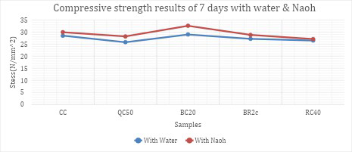
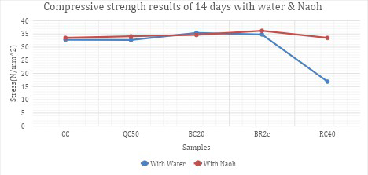
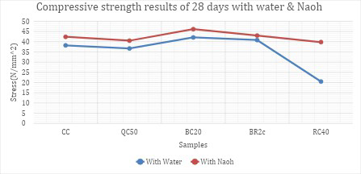
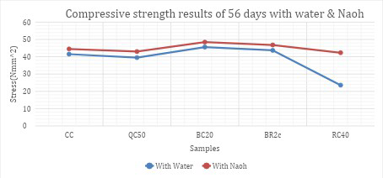

Slide 10
Brazilian Strength test of Concrete Mixes
Brazilian test
with water |  |  |  |  | with Naoh
SAMPLES | 7 Days | 14 Days | 28 Days | 56 Days | 7 Days | 14 Days | 28 Days | 56 Days
CC | 2.1 | 2.4 | 2.9 | 3.2 | 2.6 | 3 | 3.4 | 3.7
QC50 | 2.3 | 2.6 | 3.1 | 3.4 | 2.4 | 2.95 | 3.3 | 3.5
BC20 | 2.5 | 2.8 | 3.3 | 3.7 | 2.6 | 3.1 | 3.5 | 3.87
BR2c | 2.6 | 2.9 | 3.5 | 3.8 | 2.7 | 3.3 | 3.6 | 3.92
RC40 | 2.2 | 2.6 | 3 | 3.3 | 2.27 | 2.8 | 3.5 | 3.76

Slide 11
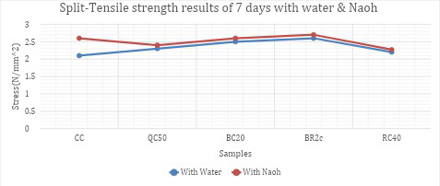
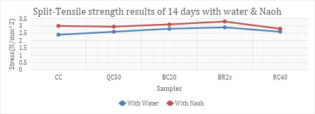
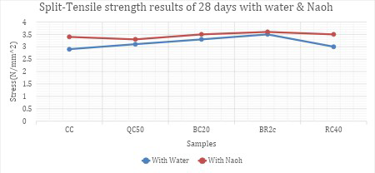
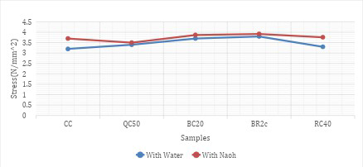

Slide 12
Bending strength test
Samples | Load | Deflection
CC | 275 | 3.2
CC(Naoh) | 245 | 2.75
BC20 (Water) | 280 | 3.3
BC20 (NaOH) | 250 | 2.8

Slide 13
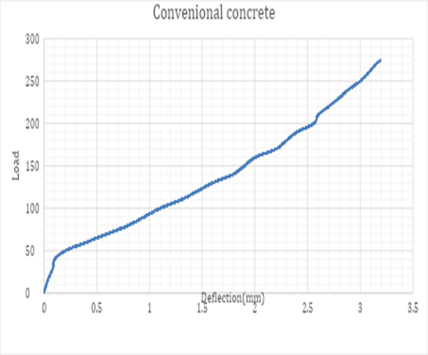
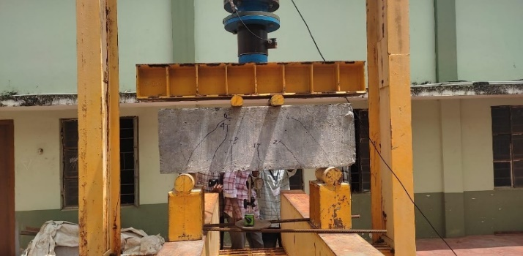
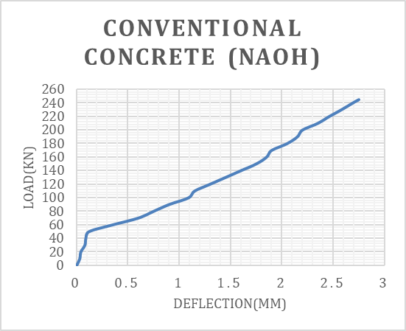
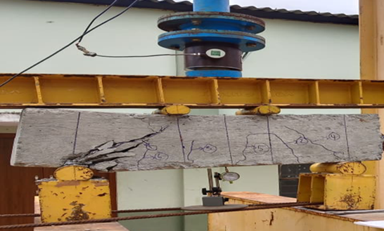

Slide 14
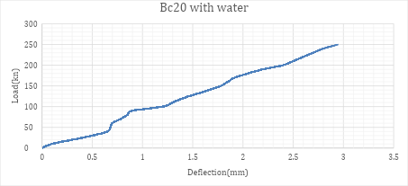
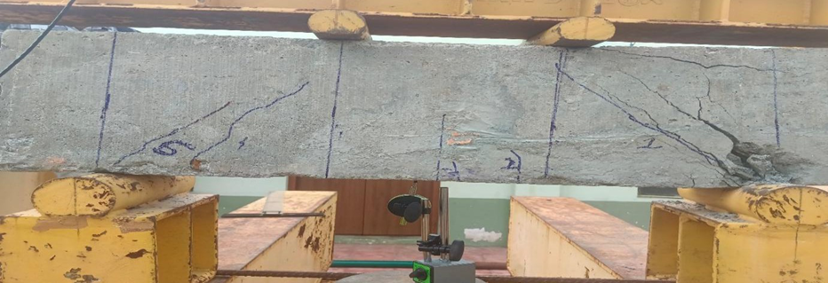
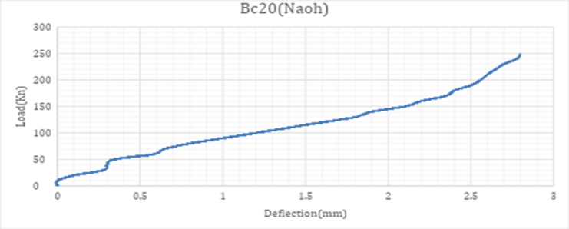
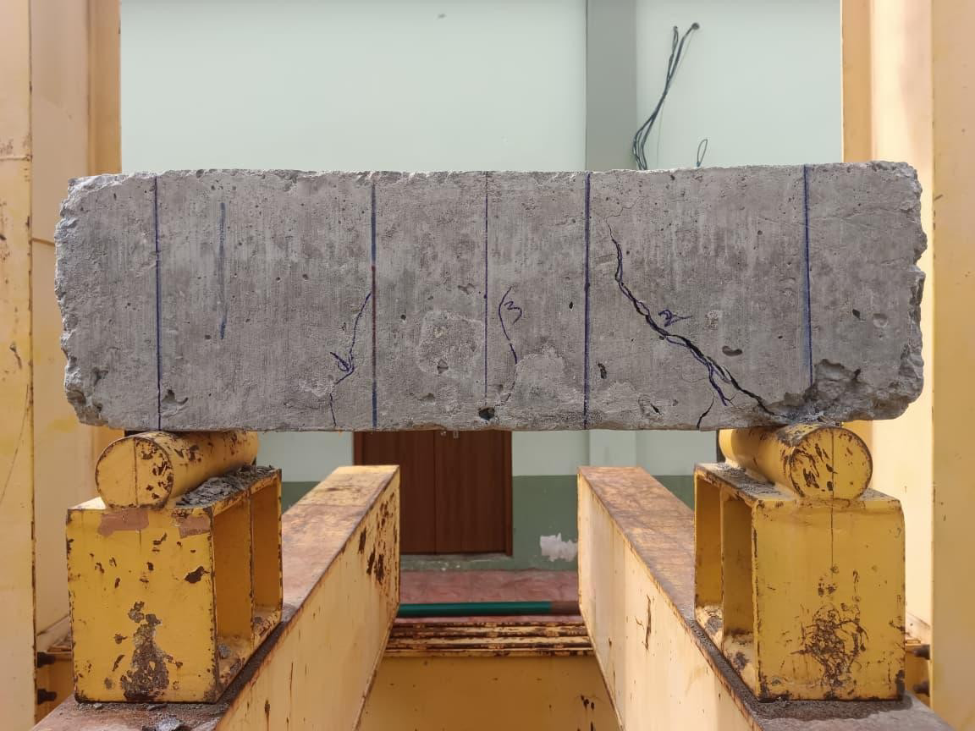

Slide 15
Conclusion:
Based on the outcomes of the experimental investigation, the following conclusions are drawn:
The Partial substitute of cement with BA and RHA, along with the substitution of manufactured sand by Pulverized rock, is both practical and effective in M30 grade concrete.
The best performance was achieved with concrete mixes incorporating 20–30% BA, 10–15% RHA, and Pulverized rock as a substitute for river sand.
At these optimal levels, the modified concrete exhibited equal or improved compressive, Brazilian test, and bending strength compared to conventional concrete.
Non-destructive testing further validated the structural quality of the modified mixes, showing improvements in surface hardness, material density, and internal homogeneity.
The integration of BA, RHA, and Pulverized rock not only conserves natural resources and reduces environmental strain but also supports the development of durable and high-performance concrete.
Overall, this study reinforces the potential of using agricultural and industrial by-products as sustainable substitutes in concrete production, aligning structural performance with environmental responsibility

Slide 16
References:
1) Rajkumar, R., Ezhumalai, G., & Gnanadesigan, M. (2021). A green approach for the synthesis of silver nanoparticles by Chlorella vulgaris and its application in photocatalytic dye degradation activity. Environmental Technology & Innovation, 21, 101282. https://doi.org/10.1016/j.eti.2020.101282
2) Ridgley, K. E., Abouhussien, A. A., Hassan, A. A. A., & Colbourne, B. (2018). Assessing abrasion performance of self-consolidating concrete containing synthetic fibers using acoustic emission analysis. Materials and Structures, 51(5), 119. https://doi.org/10.1617/s11527-018-1247-3
3) P. K. Akarsh, G. O. Ganesh, S. Marathe, and R. Rai, “Incorporation of Sugarcane Bagasse Ash to investigate the mechanical behavior of Stone Mastic Asphalt,” Constr. Build. Mater., vol. 353, p. 129089, Oct. 2022, doi: 10.1016/j.conbuildmat.2022.129089.
4) Hakeem, I. Y., Amin, M., Agwa, I. S., Rizk, M. S., & Abdelmagied, M. F. (2023). Effect of using sugarcane leaf ash and granite dust as partial replacements for cement on characteristics of ultra-high performance concrete. Case Studies in Construction Materials, 19, e02266. https://doi.org/10.1016/j.cscm.2023.e02266
5) J. A.Adebola, C. M. Ikumapayi, and C. Arum, “Effectiveness of Rice Husk and Sugarcane Bagasse Ashes Blended Cement in Improving Properties of Concrete,” J. Mater. Sci. Chem. Eng., vol. 11, no. 08, pp. 1–19, 2023, doi: 10.4236/msce.2023.118001.
6)K. Gedela Santhosh, S. M. Subhani, and A. Bahurudeen, “An investigation on the effectiveness of quarry dust and sugarcane bagasse ash in Na-based alkali-activated binder,” Mater. Today Proc., p. S2214785323016012, Apr. 2023, doi: 10.1016/j.matpr.2023.03.53

